Slide 1
Enthalpy - Calorimetry
11 Chemistry

Slide 2
Learning objectives
• Calculate the heat change (Q) for a substance given the mass, specific heat capacity and temperature change. (Formula: Q = mcΔT)
• Analyse data for heat of combustion, heat of neutralisation and reactions in aqueous solutions to determine heat, mass, specific heat capacity, temperature and enthalpy change.

Slide 3
calorimetry
Calorimetry is a method used to measure the amount of heat released from or absorbed by a chemical reaction.
In a basic calorimetry experiment:
A known amount of a substance is reacted.
The temperature change is measured over the course of the reaction.
The experiment needs to be insulated to prevent energy transfers to and from the surroundings.
A calorimeter can be used to prevent loss or addition of heat from the surroundings.

Slide 4
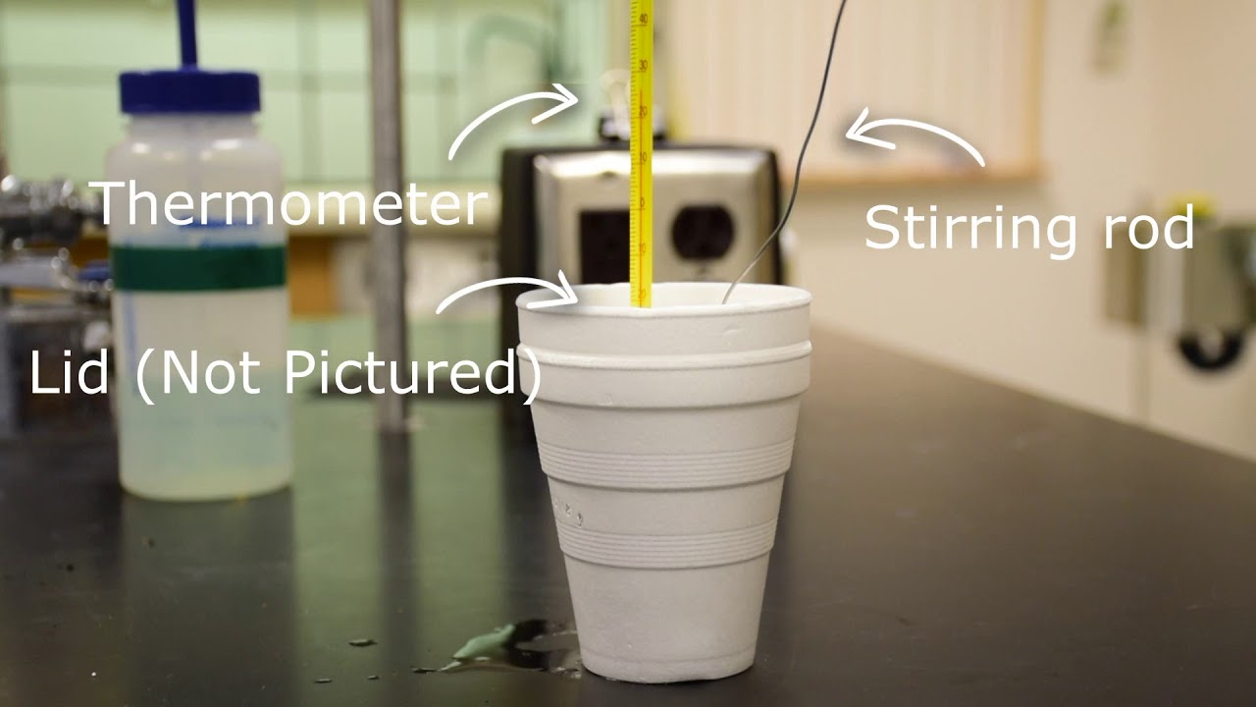
Example calorimetry setup

Slide 5
calorimetry
Calorimetry is a method used to measure the amount of heat released from or absorbed by a chemical reaction.
The heat change (q) can be calculated using the equation:
Heat change – amount of energy released from or absorbed by the reaction.
q = mc∆T
_{Where:}
q = amount of energy absorbed or released (J)
_{m = mass (g)}
c = specific heat capacity (J / g / K)
_{∆T = change in temperature (K)}

Slide 6
Check your understanding
q = mc∆T
_{Where:}
q = amount of energy absorbed or released (J)
_{m = mass (g)}
c = specific heat capacity (J / g / K)
_{∆T = change in temperature (K)}
An experiment is conducted where 10 g of dilute acid is reacted with a magnesium strip in a coffee cup calorimeter.
Before adding the magnesium strip, the temperature of the acid was 23.6˚C.
After adding the magnesium strip, a lid was put on the calorimeter and the mixture was constantly stirred. The temperature was observed to increase to a maximum of 24.7˚C.
Calculate the change in heat (q) for this reaction.
Specific heat capacity of water = 4.184 J/g

